Slide 1
Orientation to Computing-I
L T P :2 0 0

Slide 2
Unit-6 (Version Control)
Overview of Git and Github
Install git and Create a GitHub account
Create a local git repository
Add a new file to the repository
Creating a commit
Creation of a new branch
Git Commands

Slide 3

What is Git and GitHub?
Git:
GitHub:
Tracks changes in source code during development.
Git is a distributed version control system.
Enables collaboration among programmers.
GitHub is a web-based Git repository hosting service
Provides source code management (SCM) and version control
Includes all Git features plus additional tools

Slide 4
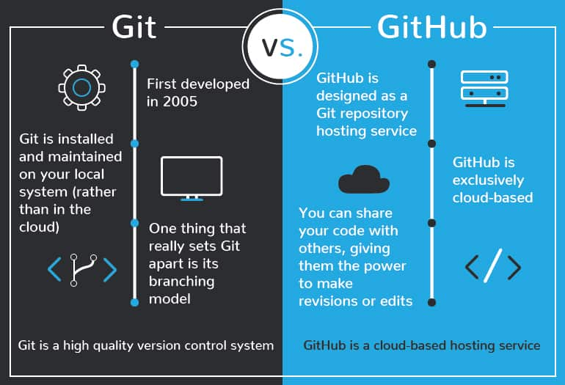
Diff. between Git and GitHub?

Slide 5
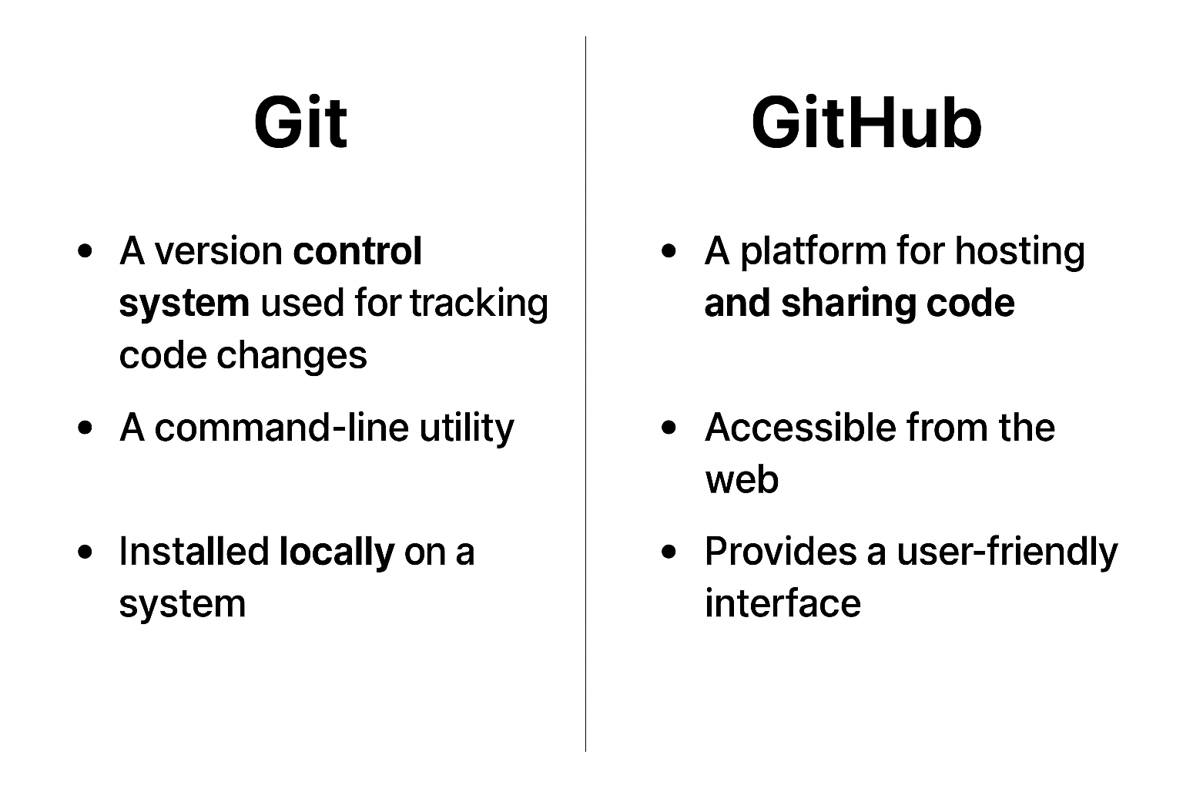
Diff. between Git and GitHub?

Slide 6
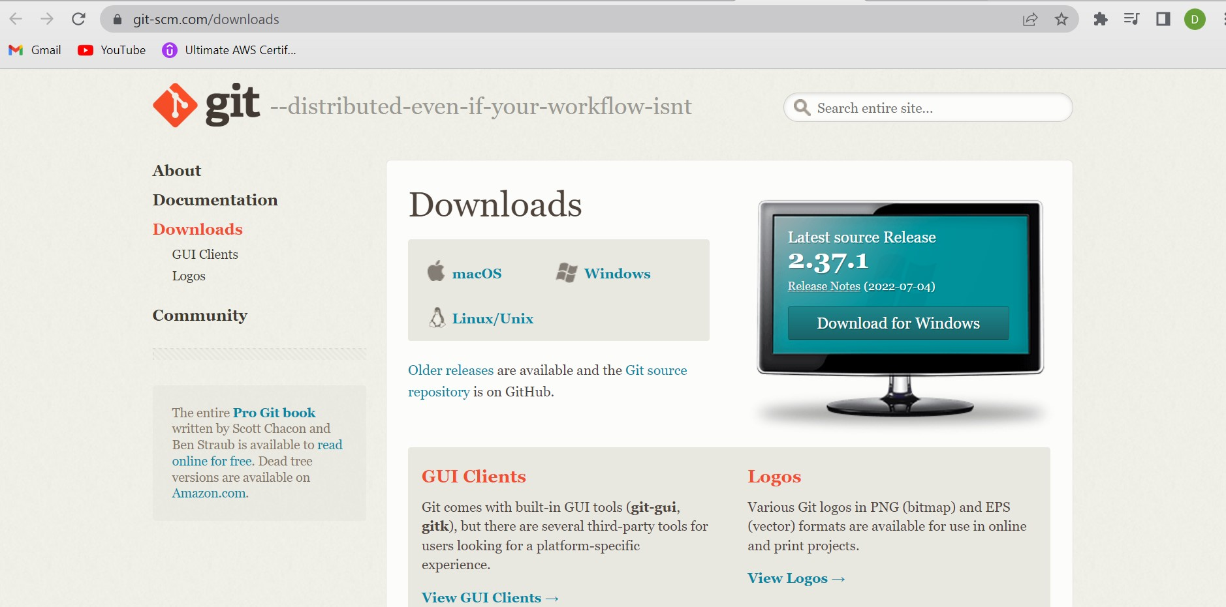
Install Git
https://git-scm.com/downloads

Slide 7
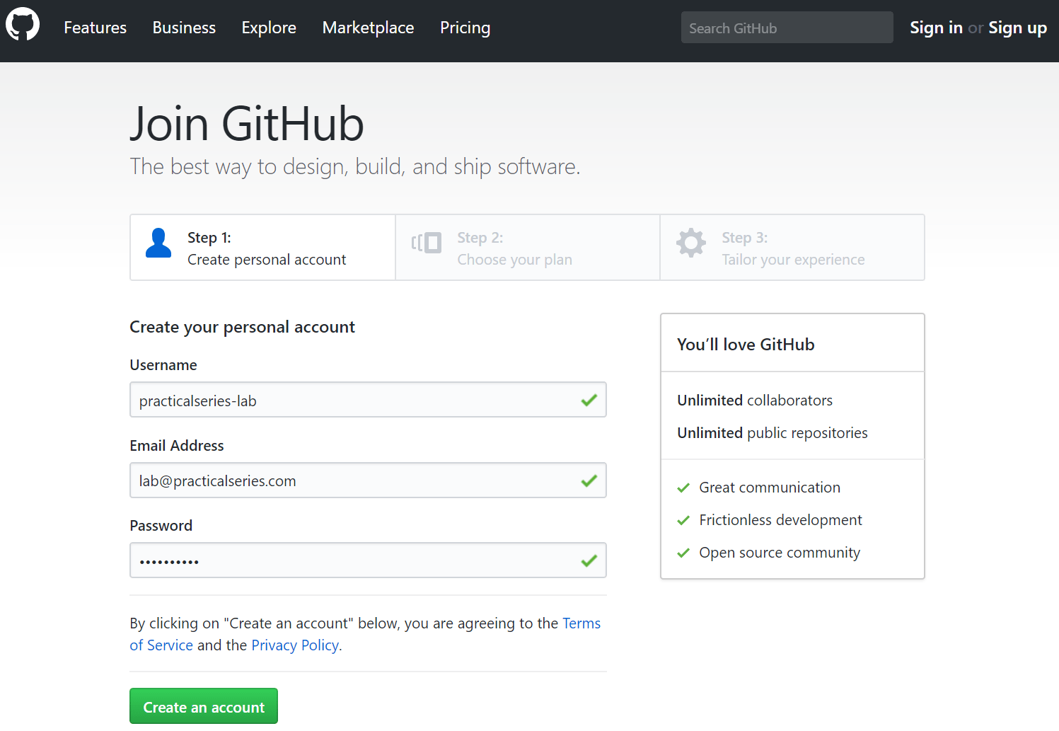
Create GitHub Account
https://github.com/

Slide 8
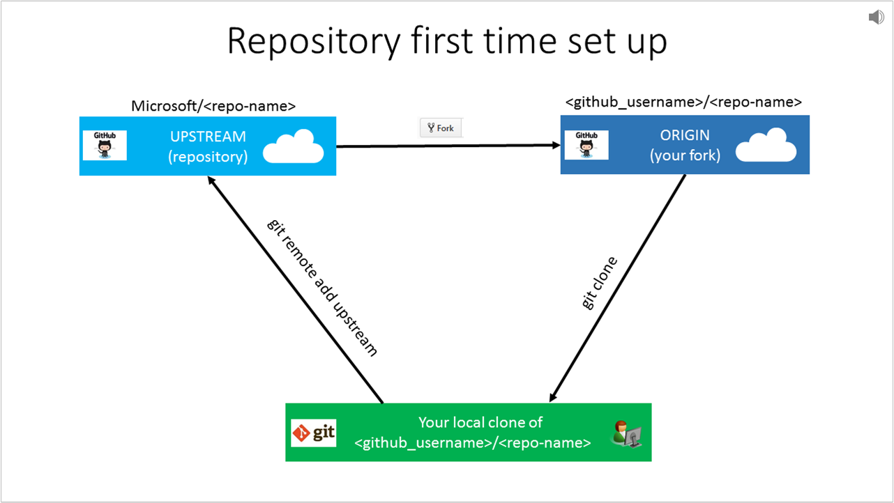
Create a local git repository
Start a new git repository
Create a directory to contain the project.
Go into the new directory.
Type git init .
Write some code.
Type git add to add the files (see the typical use page).
Type git commit .
Notes:
https://kbroman.org/github_tutorial/pages/init.html

Slide 9
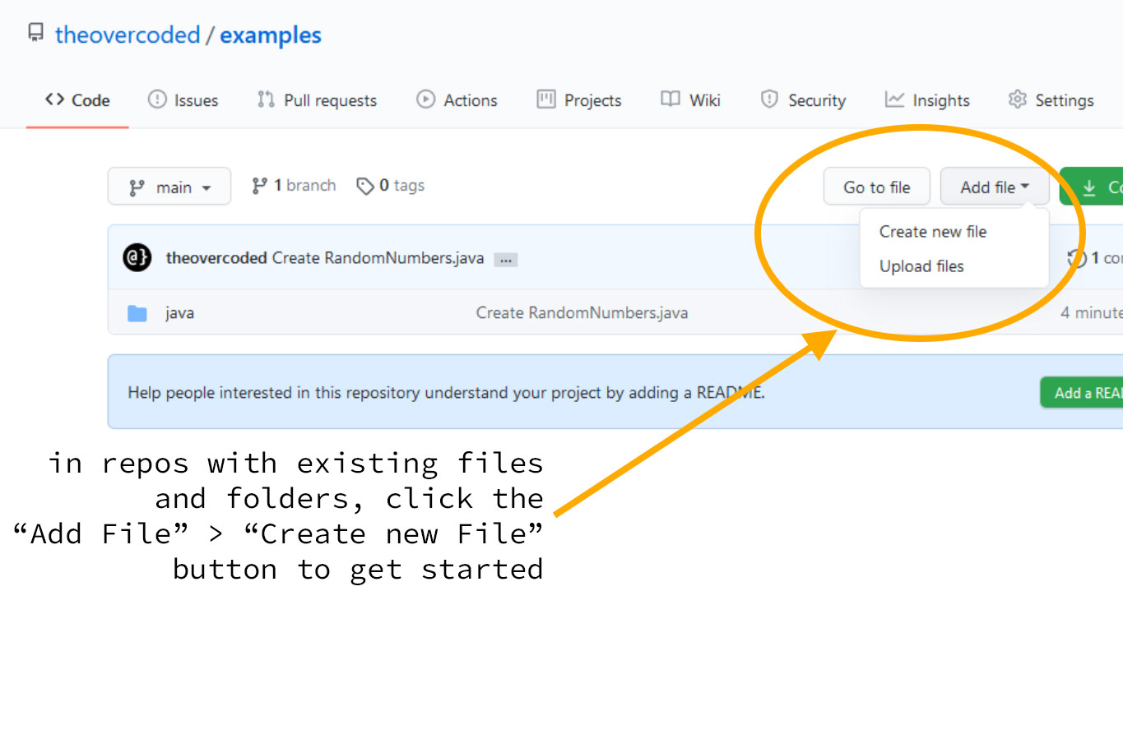
Create your new files or edit existing files in your local project directory.
Enter git status to see the changes to be committed.
Add a new file to the repository
Create the file you want to add
e.g., touch file.txt or using a code editor.
Use git add file.txt to stage the new file.
Use git commit -m "Add new file" to commit the change.
Use git push to upload it to the remote repository.

Slide 10
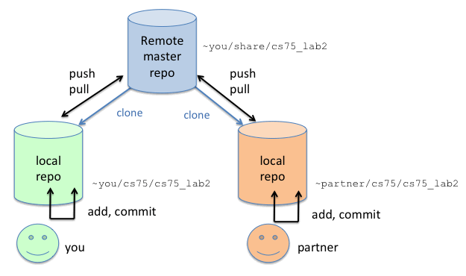
Creating a Commit

Slide 11
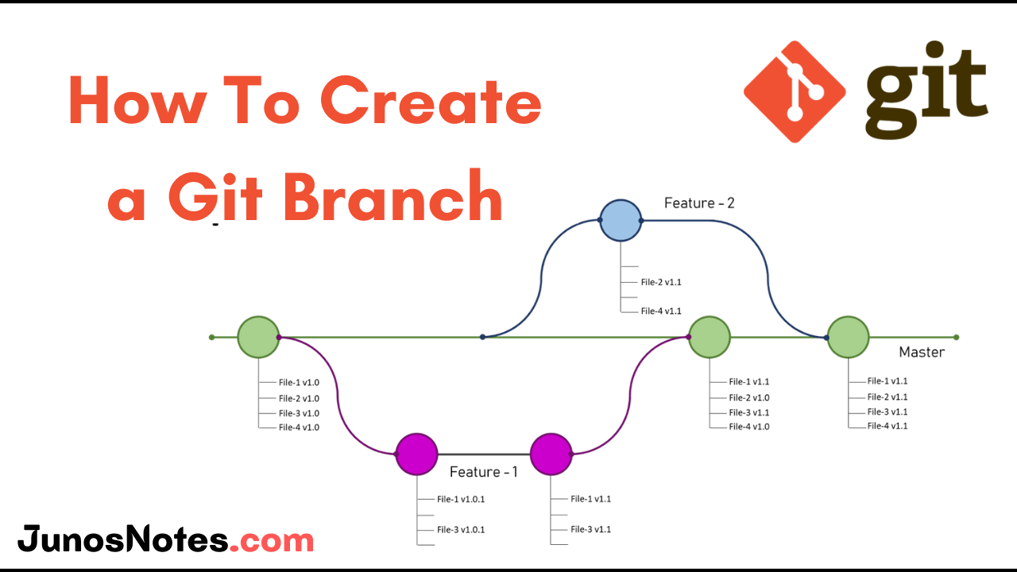
Use git branch new_branch to create a new branch.
Use git checkout new_branch to switch to the new branch.
Creating a branch is useful when starting a new feature.
New branches are usually created from the main branch.
Creation of a new branch

Slide 12






Git Commands
Learn the concept of controlling, forking, building repositories

Slide 13




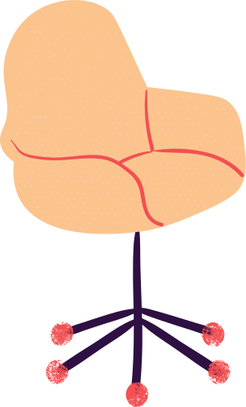
Git Commands
Introduce yourself to Git
$ git config --global user.name {given name}
$ git config --global user.email {given email}

Slide 14
Git Commands
Run your code editor
$ code.

Slide 15
Git Commands
Intialize empty Git repository
$ git init

Slide 16
Git Commands
Adding the work to staging area
$ git add {filename}

Slide 17
Git Commands
Commiting from stage to final
$ git commit

Slide 18
Git Commands
add new file to repository
$ touch {file name}

Slide 19
Git Commands
If you want all files to be added to staging area
$ git add -A

Slide 20
Git Commands
Adding comments while inserting commits
$ git commit -m "your comment"

Slide 21
Git Commands
Undo the work done by mistake in staging area from a file
$ git checkout {filename}

Slide 22
Git Commands
Recovery for multiple files altogether
$ git checkout -f

Slide 23
Git Commands
Check for complete logs
$ git log
Check for complete logs but with numbered steps
$ git log -p -{mention no of steps}

Slide 24
Git Commands
To check for changes in file
$ git diff

Slide 25
Git Commands
Auto commit all files in staging area
$ git commit -a -m "Comment"

Slide 26
Git Commands
Removing files
$ git rm {filename}

Slide 27
Git Commands
Branching into repository
$ git branch {branch name}
Switching to new branch
$ git checkout {branchname}

